Slide 1

Software Measurement and Analysis
Team Assignment 10

Slide 2





Contents
Purpose
Participants Roles
and Responsibilities
Viking Project Risk Management
References

Slide 3
Purpose
The purpose of this document is to keep track of the risks that have been identified and prioritized by HIT. Since the HIT team is taking a risk driven approach to the project, the list of these risks that will be used as a guide to strategy and planning.
The Risk Management Plan is created by the project manager in the Planning Phase of the RUP Process and is monitored and updated throughout the project. This document also defines the risk management roles and responsibilities of the
HIT Team.

Slide 4
Document Maintenance
This document will be reviewed annually and updated as needed, as the project proceeds through each phase of the system development life cycle.
This document contains a revision history log. When changes occur, the document’s revision history log will reflect an updated version number as well as the date, the owner making the change, and change description will be recorded in the revision
history log of the document

Slide 5
Contents
Purpose
Participants Roles
and Responsibilities
Viking Project Risk Management
References

Slide 6
Participants Roles and Responsibilities
This section describes the roles and responsibilities of the Viking staff with regard to the Risk Management Plan. Note that these are roles, not positions or titles. One person may fulfill more than one role. Avoid listing specific names as this will lead to frequent maintenance updates to the plan.
There are various staff resources and stakeholders involved in managing project
risks. In some cases, one individual may
perform multiple roles in the process.

Slide 7

Participants Roles and Responsibilities
Project Director
Project Manager (PM)
Project
Stakeholders
and Vendors
Risk Manager/ Plan Manager
Risk Analyst

Slide 8
Project Director
The Project Director is involved in monitoring risk action effectiveness and participating in risk escalation. The Project Director also has the responsibility to communicate to certain project stakeholders, on an as needed basis.

Slide 9
Project Manager (PM)
The role of the VIKING Project Manager is to write and approve the VIKING Project Risk Management Plan, define the Risk Management process, participate in the Risk Management process, and take ownership of risk mitigation planning and execution

Slide 10
Risk Manager/ Plan Manager
The Risk Manager is responsible for leading the risk management effort, sponsoring risk identification activities, facilitating communication throughout the execution of the risk management process, and the statuses assigned to risks and risk activities are current. The Risk Manager is responsible for providing the Project Manager with recommendations and statuses on risk actions.

Slide 11
Risk Analyst
The Risk Analyst’s role is to evaluate risks, maintain the Risk Management database, and facilitate communication throughout the execution of the process.

Slide 12
Project Stakeholders and Vendors
The role of VIKING Project stakeholders and vendors is to participate in the Risk Management process by providing candidate risk input, and supporting risk mitigation planning and execution activities.

Slide 13
Contents
Purpose
Participants Roles
and Responsibilities
Viking Project Risk Management
References

Slide 14
Viking Project Risk Management
Risk Management provides a disciplined environment to:
Access continuously any possible errors that could occur (risks)
Determine which risks are important to deal with
Implement strategies to deal with those risks

Slide 15
Risk Assessment
Risk in Cycle 1
Risk Attributes
Evaluating the attributes of a risk involves establishing the current values for:
Impact: the loss or effect on the project if the risk occurs
Probability: the likelihood the risk will occur
Timeframe: the period when action is required in order to mitigate the risk

Slide 16
Risk Attributes
Impact:
High – Risk that has the potential to greatly impact project cost, project schedule or performance (H): schedule delay more than one month
Middle – Risk that has the potential to slightly impact project cost, project schedule or performance (M): schedule delay between two weeks and one month
Low – Risk that has relatively little impact on cost, schedule or performance (L): schedule delay less than two weeks

Slide 17
Risk Attributes
Probability:
High (H): 90% +
Middle (M): 51% - 90%
Low (L): 00% - 50%
Risks that fall within the RED and YELLOW zones will have risk response planning which may include both a risk mitigation and a risk contingency plan.

Slide 18
Risk Attributes
Timeframe:
Near: next 2 weeks
Mid: next 3 weeks
Far: > 1.5 months

Slide 19
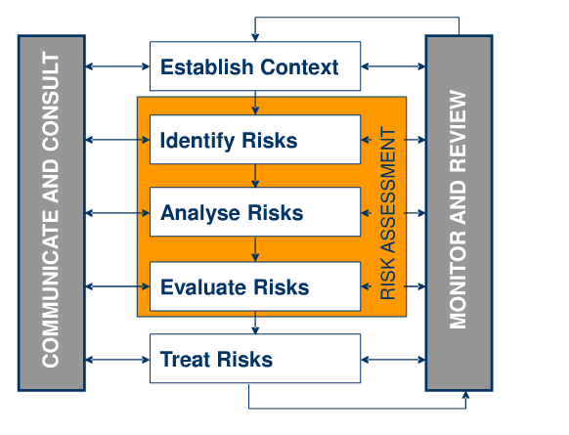
Risk Management Process

Slide 20
Risk Management Process
This paradigm portrays the high-level process steps of the Risk Management process, which are:
Step 1 – Identify: Search and locate risks BEFORE they materialize
Step 2 – Analyze: Process risk data into decision-making information
Step 3 – Evaluate Risk: Priority Risks by 3 Attributes: Impact, Probability and Timeframe
Step 4 – Treat Risk
Plan: Translate risk information into decisions and actions (mitigations)
Implement: Execute decisions and mitigation action plans

Slide 21
Risk Management Process
Through the process, project team also has to:
Track/Control
Monitor risk indicators and mitigation actions
Correct for deviations from planned risk actions
Communicate: Information and feedback throughout all risk management functions and project organizations

Slide 22
Risk Solution
Please read The Risk Mitigation Column in file Excel

Slide 23
Identify and Track Risks
The level of risk on a project will be tracked, monitored and reported throughout the project lifecycle. HIT team identifies and tracks risks every week through status meetings.

Slide 24
Contents
Purpose
Participants Roles
and Responsibilities
Viking Project Risk Management
References

Slide 25
References
A.J. Dorofee, J.A. Walker, C.J. Alberts, R.P. Higuera, R.L Murphy, and R.C Williams, Continuous Risk Management Guidebook, Software Engineering Institute, 1996.
PMBOK Guide, 3rd Edition, Section 11 - Project Risk Management
IEEE Standard 1012-1998: IEEE Standard for Software Verification and Validation

Slide 26
Thanks
for your listening!

